Slide 1
Preprocessing steps done:
Single file check:
  Upload file kent0001.vhdr to EEGLAB
  Verb epoching for expected nouns sentences (S205) – [-1 0.5] sec
  Baseline correction [-1 -0.5] sec
  Sanity check - Channel data (scroll)
  Data cleansing – removing blinks using ICA maps
  Rejecting extreme values [-100 100] uV
  Plot ERP (rectangular array) – focus on Pz, Cz, CP1, CP2 electrodes

Slide 2
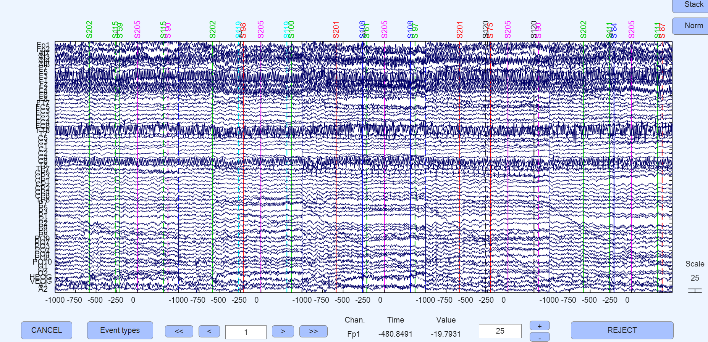
Sanity check - Channel data (scroll)

Slide 3
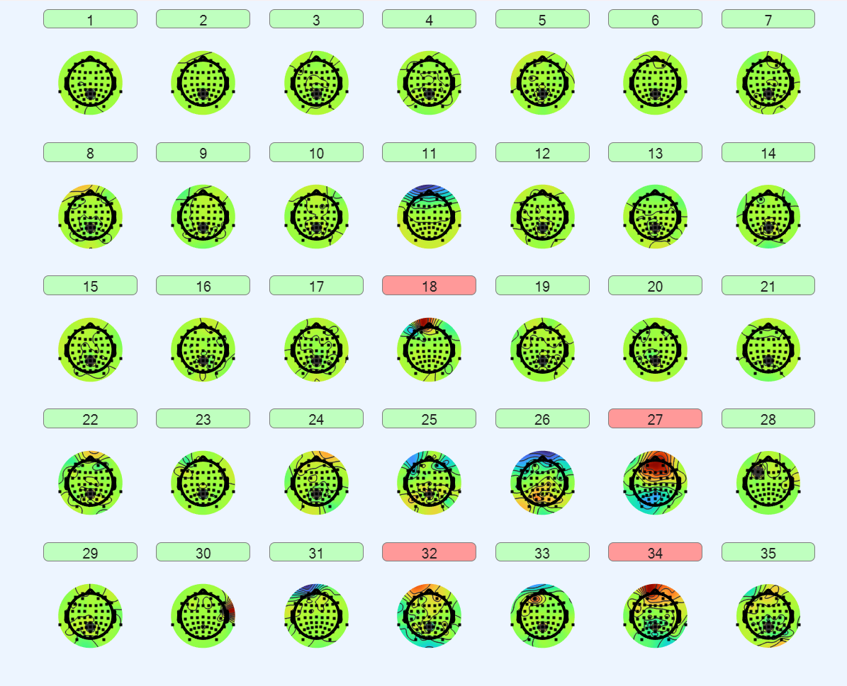
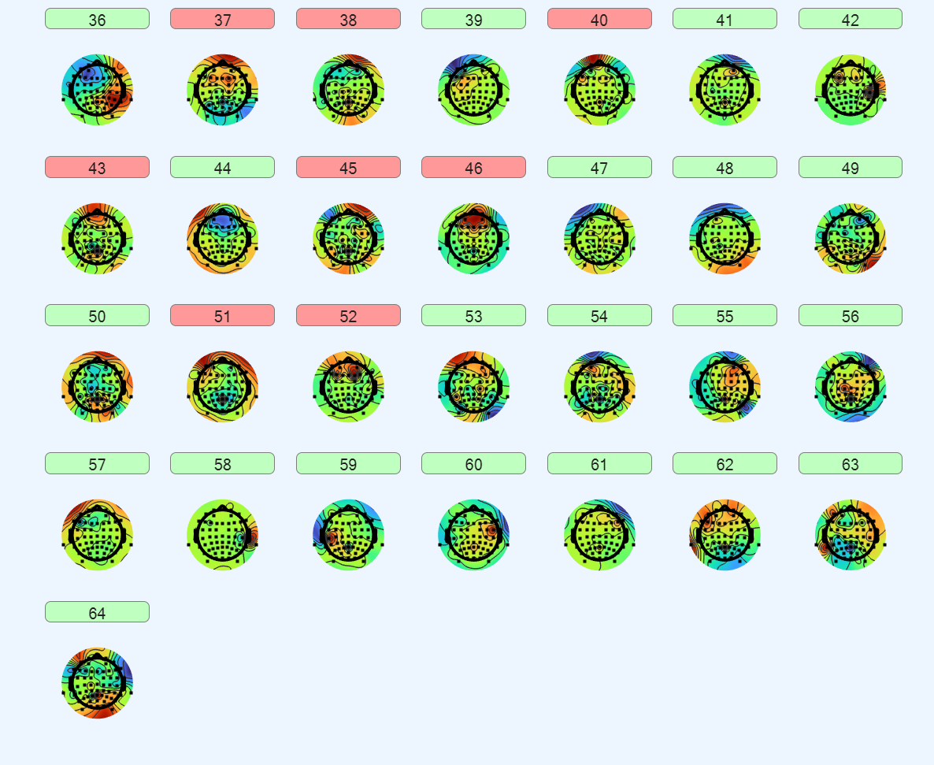
Data cleansing – removing blinks using ICA maps

Slide 4
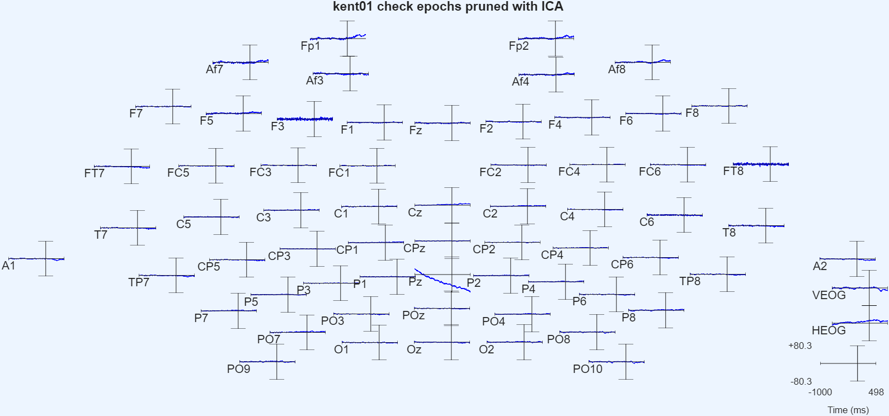
Plot ERP (rectangular array) – focus on Pz, Cz, CP1, CP2 electrodes

Slide 5
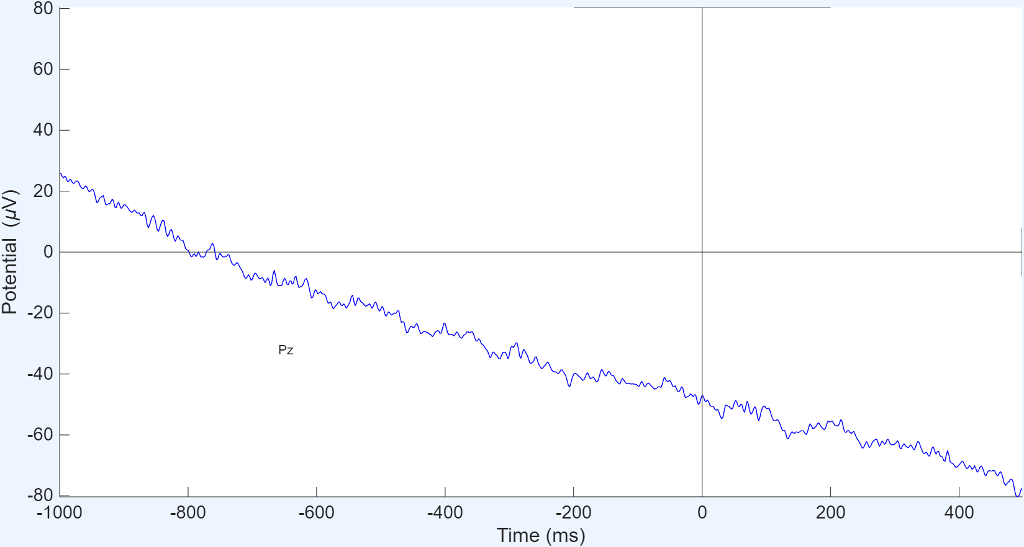
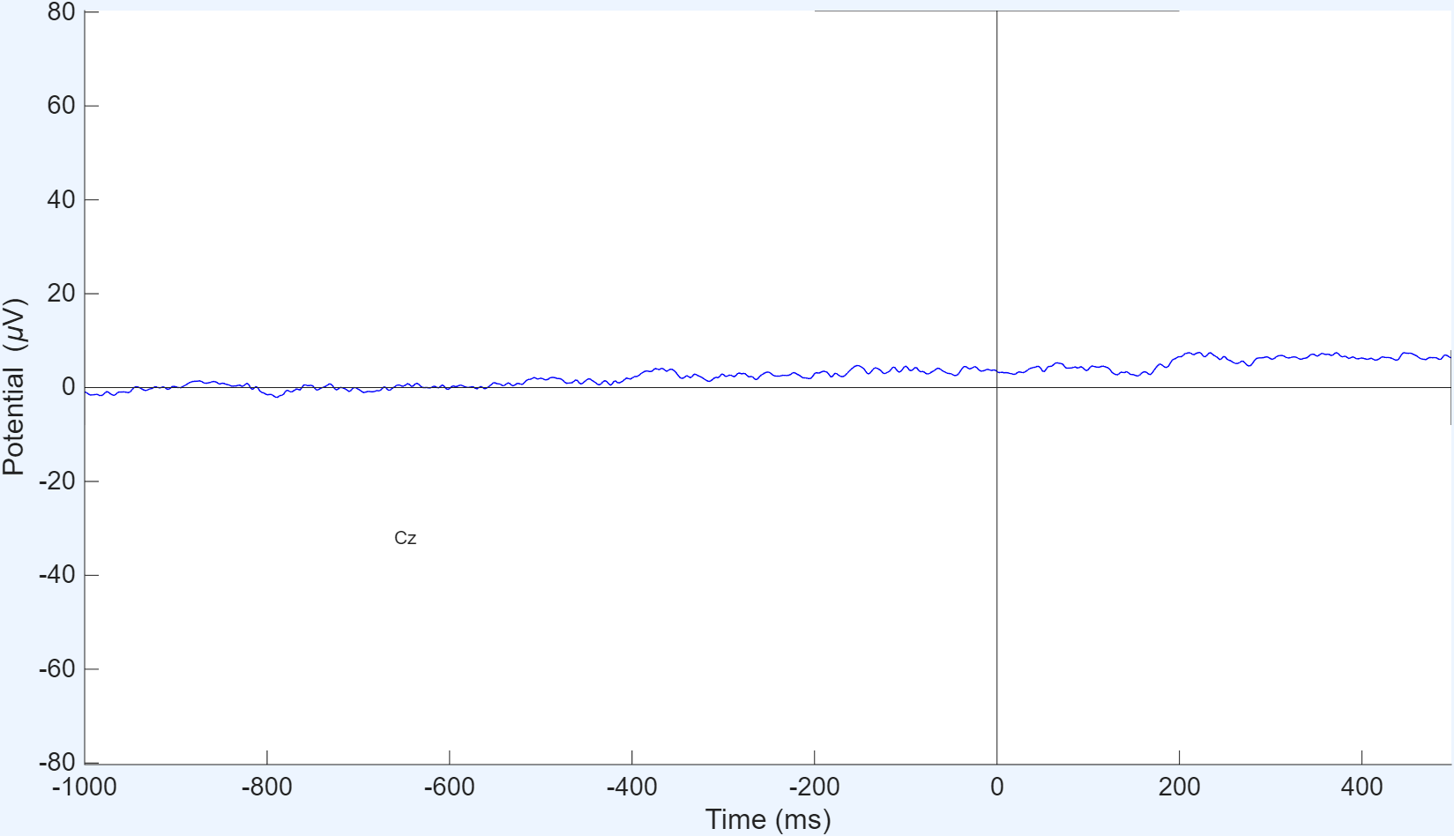
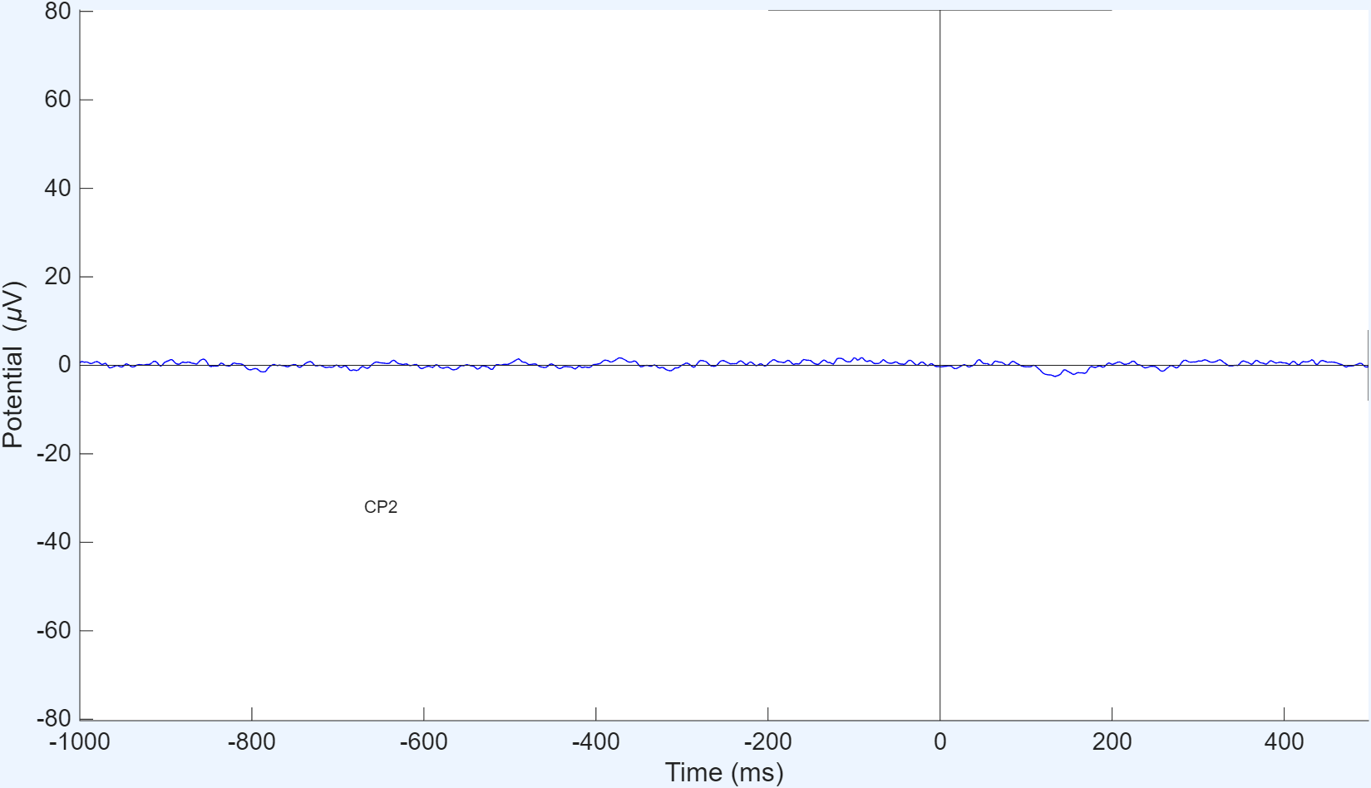
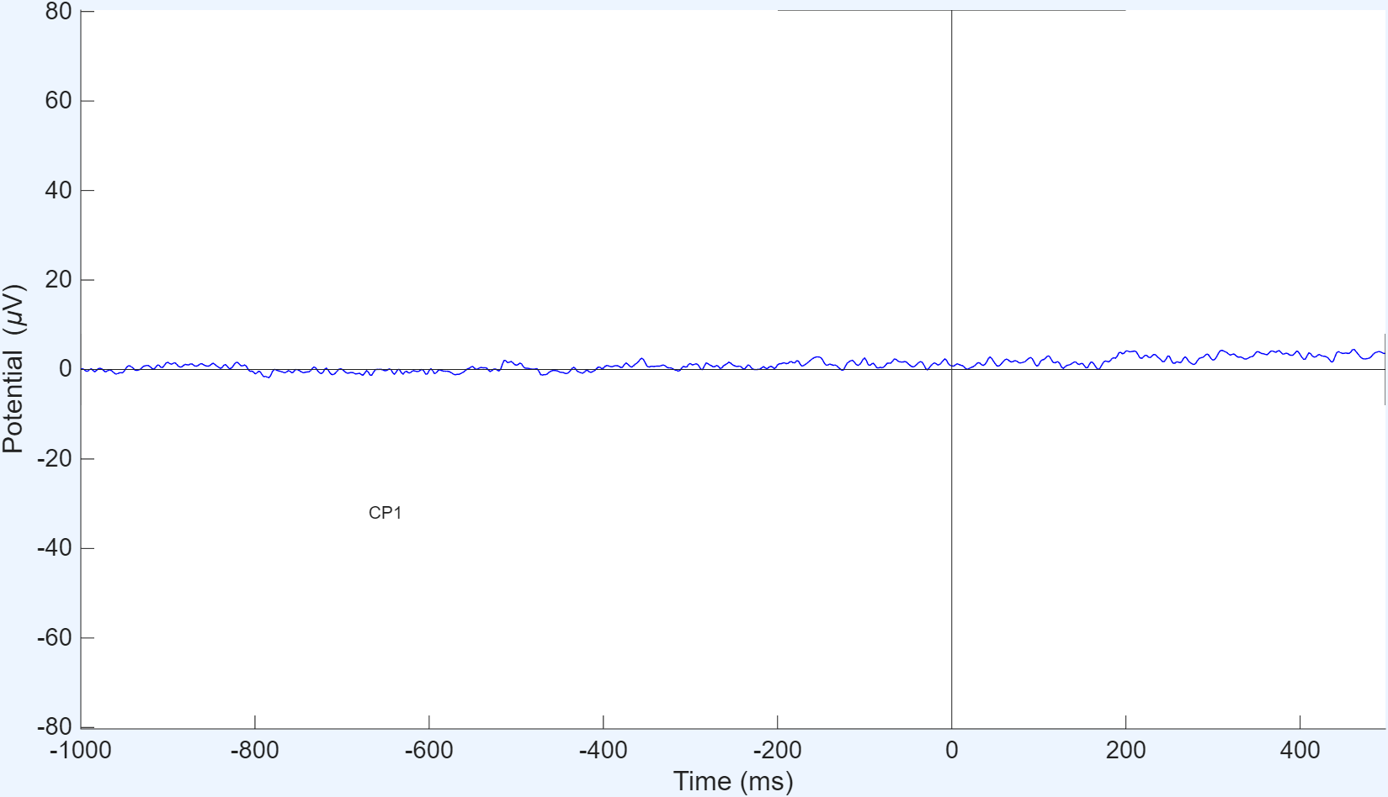
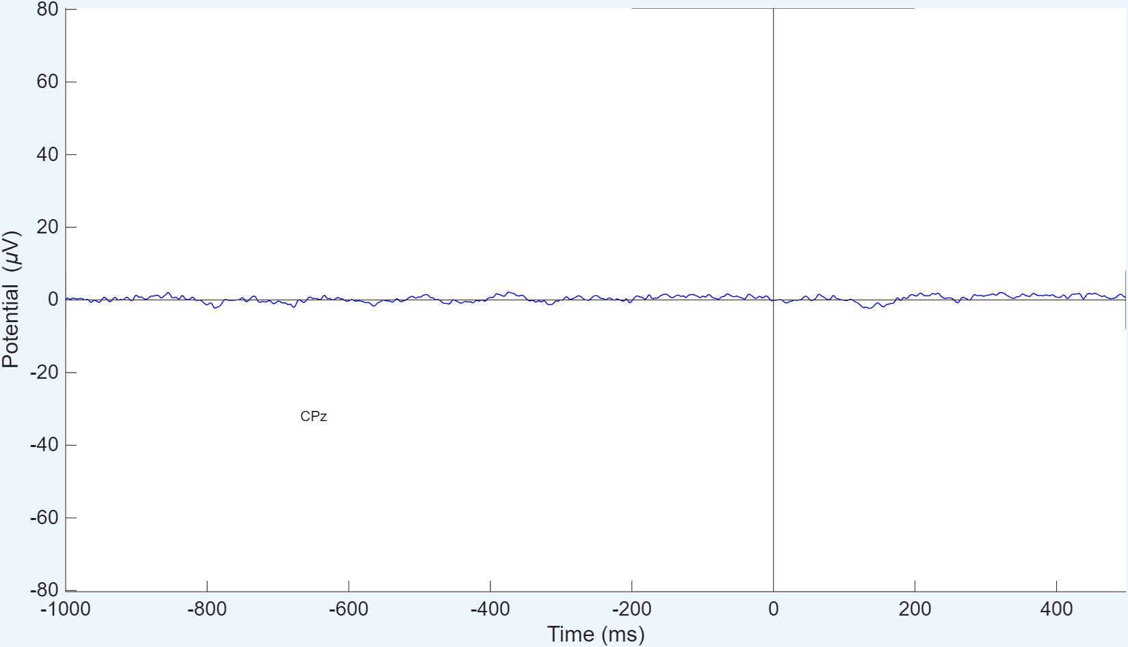
Plot ERP (rectangular array) – focus on Pz, Cz, CP1, CP2 electrodes
Should Interpolate electrode?

Slide 6
Next steps:
Run process on all data
Statistical analysis

